Slide 1
Tips and Tricks
AI ToolKit
Fall Semester, 2023
Notes:
How can summarize matrices, how matrices can be decomposed.

Slide 2
Do not forget to normalize the input and output
Example: when input value range is different from element to element.
X1 = [x_11, x_12, x_13, x_14, x_15] = [10, 0.1, 0.4, 0.001, 100]
X2 = [x_21, x_22, x_23, x_24, x_25] = [20, 0.01, 0.7, 0.0001, 200]
⇒ for each j-th element,
Calculate mean(x_1j, x_2j, …, x_kj) and std(x_1j, x_2j, … x_kj)
Normalize x_ij by (x_ij - mean_j)/std_j

Slide 3
Do not forget to normalize the input and output
Example: when output value range is different from element to element.
Y1 = [y_11, y_12, y_13, y_14, y_15] = [10, 0.1, 0.4, 0.001, 100]
Y2 = [y_21, y_22, y_23, y_24, y_25] = [20, 0.01, 0.7, 0.0001, 200]
⇒ for each j-th element,
Calculate mean(y_1j, y_2j, …, y_kj) and std(y_1j, y_2j, … y_kj)
Normalize y_ij by (y_ij - mean_j)/std_j
Use normalized value as your ground truth for prediction
If you obtain y’_ij from the model, un-normalize the result y’_ij*std_j + mean_j

Slide 4
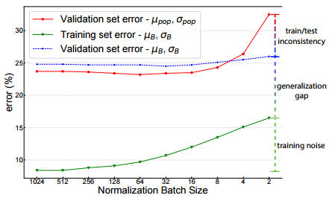
Set larger batch size when using batch normalization
When the batch size is small, the sample mean and std will not be able to represent the real distribution.
Which can make network not to learn anything.
https://arxiv.org/abs/2105.07576

Slide 5
Be familiar with your task with a toy example + overfitting
Imagine that you are solving a challenging task, but you do not have any clue of whether this task can be solved or not..
In this case, people usually finish building code for everything, put a large batch size from whole dataset, run the code, and waiting for the loss to be decreased.
But before that, I would recommend to check the “possibility” of your work.
To do this, one can prepare a very small subset from your dataset, and try to “overfit” your model on it.
ex) In image segmentation, give one data pair (rgb image, segmentation map) to the model until it overfits to the ground truth segmentation map.
If you model even failed to “overfit”, then it means something severe needs to be fixed.

Slide 6
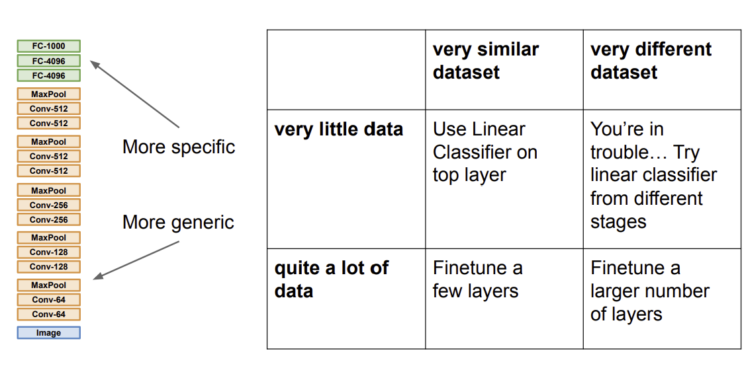
Properly set up how much to freeze the pretrained model
http://cs231n.stanford.edu/slides/2023/lecture_6.pdf

Slide 7
Transformer is not always best solution
Do not trust all existing SOTA methods
Do not ignore classic methods

Slide 8
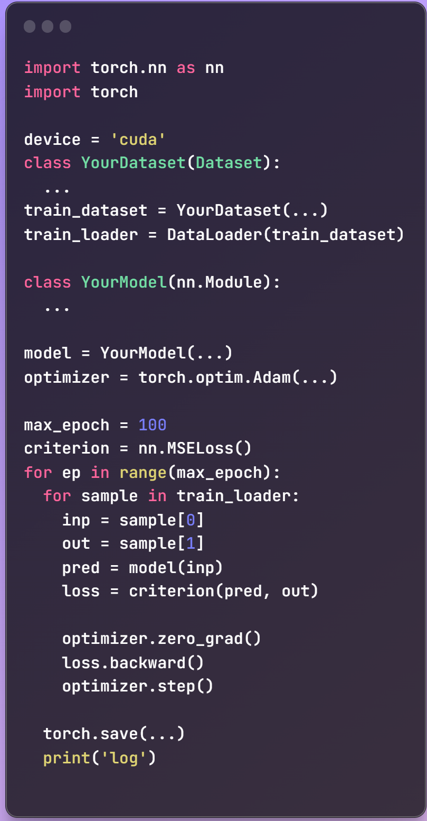
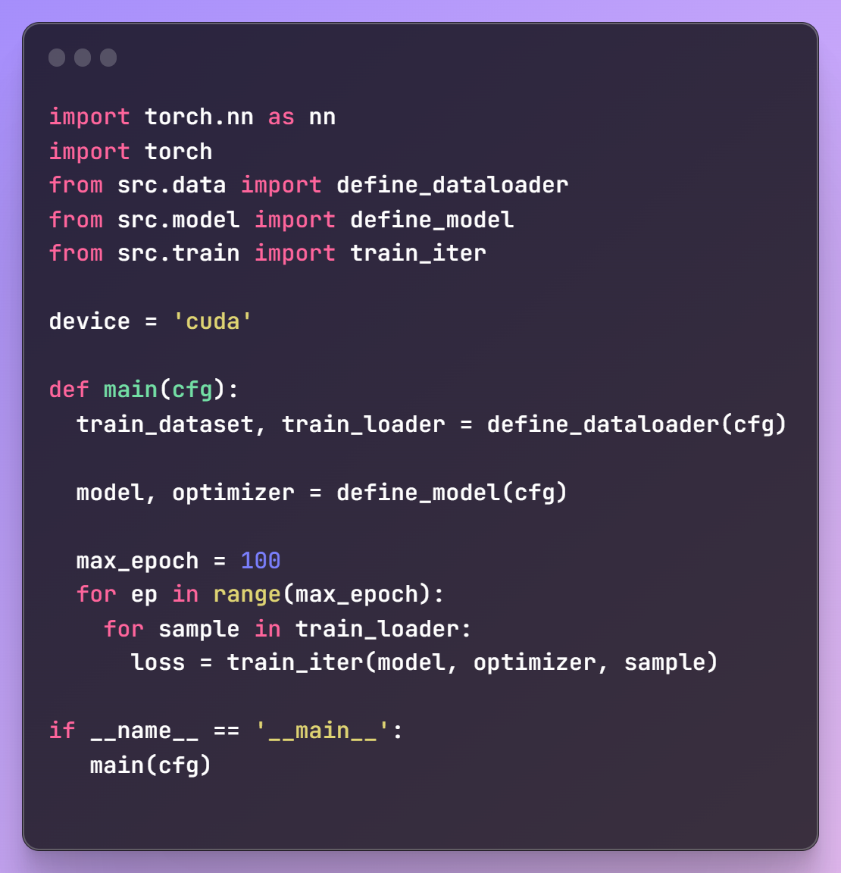
Modularize your code

Slide 9

Pytorch Lightning can be useful

Slide 10
Any Questions?

